Slide 1
Unit-9: Project Procurement Management 5LHr

Slide 2
Procurement management process flow
Plan purchases and acquisition process
Bid document preparation
Evaluation and selection criterion
Contract process plan
Standard forms
Contract administration process
Contract closure process
Public procurement legalities in local context such as Nepalese PPMO guidelines
E-bidding procedures

Slide 3
THE IMPORTANCE OF PROJECT PROCUREMENT MANAGEMENT
Procurement means acquiring goods and services from an outside source
Other terms include purchasing and outsourcing
Organizations or individuals who provide procurement services are referred to as suppliers, vendors, contractors, subcontractors, or sellers; of these terms, suppliers is the most widely used
Deciding whether to outsource, what to outsource, and how to outsource are important topics for many organizations throughout the world

Slide 4
Why Outsource?
To access skills and technologies
To reduce both fixed and recurrent costs
To allow the client organization to focus on its core business
To provide flexibility
To increase accountability

Slide 5
Contracts
A contract is a mutually binding agreement that obligates the seller to provide the specified products or services and obligates the buyer to pay for them
Contracts can clarify responsibilities and sharpen focus on key deliverables of a project
Because contracts are legally binding, there is more accountability for delivering the work as stated in the contract
A recent trend in outsourcing is the increasing size of contracts

Slide 6
Types of Contract
Fixed-price or lump-sum contracts The contract involves fixed price for a defined product or services or the result to be supplied/provided.
Cost-reimbursable contracts – Generally involves payment to the vendor for actual cost plus a fee for profit. Actual costs comprise direct and indirect cost of making the product or providing the service. There are three common types of cost-reimbursable contracts.
Cost-Plus-Fee (CPF) or Cost-Plus-Percentage of Cost (CPPC) – In this type, the seller is reimburse for the allowable costs and receives a percentage of the costs as a fee.
Cost-Plus-Fixed-Fee (CPFF) – For this type, the vendor is reimbursed for allowable costs and receives a fixed fee. The fee normally doesn’t change unless scope changes allocate a new fee.
Cost-Plus-Incentive-Fee (CPIF) – Cost-Plus-Incentive reimburse the seller for allowable costs and allocates a predetermined fee, as an incentive for achieving certain performance objectives.

Slide 7
Time and Material contracts – T&M contracts are a hybrid combination of cost-reimbursable and fix price contracts. A common indicator is their open-ended nature. The full value of the agreement and the exact quantity of items to be delivered are not defined at the time of contract award.
Unit pricing can also be used in various types of contracts to require the buyer to pay the supplier a predetermined amount per unit of product or service. The total value of the contract is a function of the quantities needed to complete the work

Slide 8
Project Procurement Management Processes
The management of processes of purchasing or acquiring the products, services, or results needed from outside the project team to perform the work is defined as project procurement management.
Plan Purchases and Acquisitions
Plan Contracting
Conducting procurement
Contract Administration / Controlling Procurement
Contract Closure

Slide 9
Plan Purchases and Acquisitions
The purpose of the plan purchases and acquisitions process is to identify which project needs can best be met by purchasing and acquiring products, services, or results outside the project organization
involves consideration of whether, how, what, how much, and when to acquire.
Emphasis should also be given to who is responsible for obtaining or holding any relevant permits and professional licenses that may be required by legislation, regulation, or organizational policy in executing the project

Slide 10
Inputs to the Plan Purchases and Acquisitions Process are:
Enterprise Environmental Factors, Organizational Process Assets such as types of contract, Project Scope Statement, Work Breakdown Structure, WBS Dictionary, Project Management Plan
Tools and techniques used are:
Make-or-buy Decisions, Expert Judgment, Market Research

Slide 11
The outputs to the Plan Purchases and Acquisitions process are:
Procurement Management Plan
The procurement management plan explains how procurement will be managed from inception to closing. Commonly the procurement management plan details:
Guidelines for types of contracts to be used in different situations
Standard procurement documents or templates to be used, if applicable
Guidelines for creating contract work breakdown structures, statements of work, and other procurement documents
Roles and responsibilities of the project team and related departments, such as the purchasing or legal department
Guidelines for using independent estimates to evaluate sellers

Slide 12
Suggestions for managing multiple providers
Processes for coordinating procurement decisions with other project areas, such as scheduling and performance reporting
Constraints and assumptions related to purchases and acquisitions
Lead times for purchases and acquisitions
Risk mitigation strategies for purchases and acquisitions, such as insurance contracts and bonds
Guidelines for identifying prequalified sellers and organizational lists of preferred sellers
Procurement metrics to assist in evaluating sellers and managing contracts

Slide 13
Plan Contracts
After planning purchases and acquisition, the next step is to plan for the contract according to which the procurement process will be based
The main outputs are Contract Statement of Work

Slide 14
Contract Statement of Work (SOW) -:
The contract statement of work explains the items being purchased with enough detail and clarifications for everyone to be in agreement with what is being purchased.
A contract SOW should be clear and as complete as possible.
It should describe all services required and include performance reporting
It is important to use appropriate wording in a contract SOW, such as must instead of may.

Slide 15
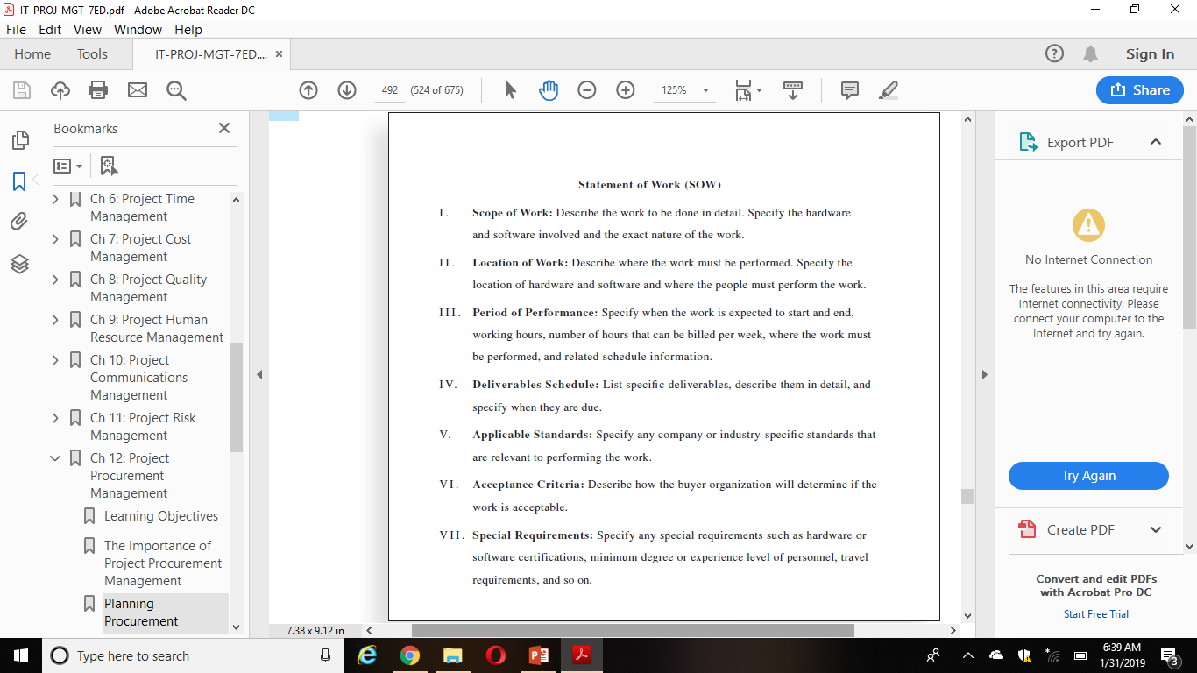

Slide 16
Standard Forms
Standard contracts, standard descriptions of procurement items, non-disclosure agreements, proposal evaluation criteria checklists, or standardized versions of all parts of the needed bid documents are included in standard forms.

Slide 17
Procurement Documents:
Two common examples of procurement documents include a Request for Proposal (RFP) and a Request for Quote (RFQ).

Slide 18
Request for Proposal (RFP):
A document used to solicit proposals from prospective suppliers.
A proposal is a document prepared by a seller when there are different approaches for meeting buyer needs
Developing an RFP is often a time-consuming process.
Organizations must plan properly to ensure that they adequately describe what they want to procure, what sellers to include in their proposals, and how they will evaluate proposals.
Request for Quote (RFQ)
A document used to ask quotes or bids from prospective suppliers.
A bid, also called a tender or quote (short for quotation), is a document prepared by sellers to provide pricing for standard items that the buyer has clearly defined.
Organizations often use an RFQ for solicitations that involve specific items.

Slide 19
All procurement documents should be written to facilitate accurate and complete responses from prospective sellers.
Procurement documents should include background information on the organization and project, a relevant statement of work, a schedule, a description of the desired form of response, evaluation criteria, pricing forms, and any required contractual provisions.

Slide 20
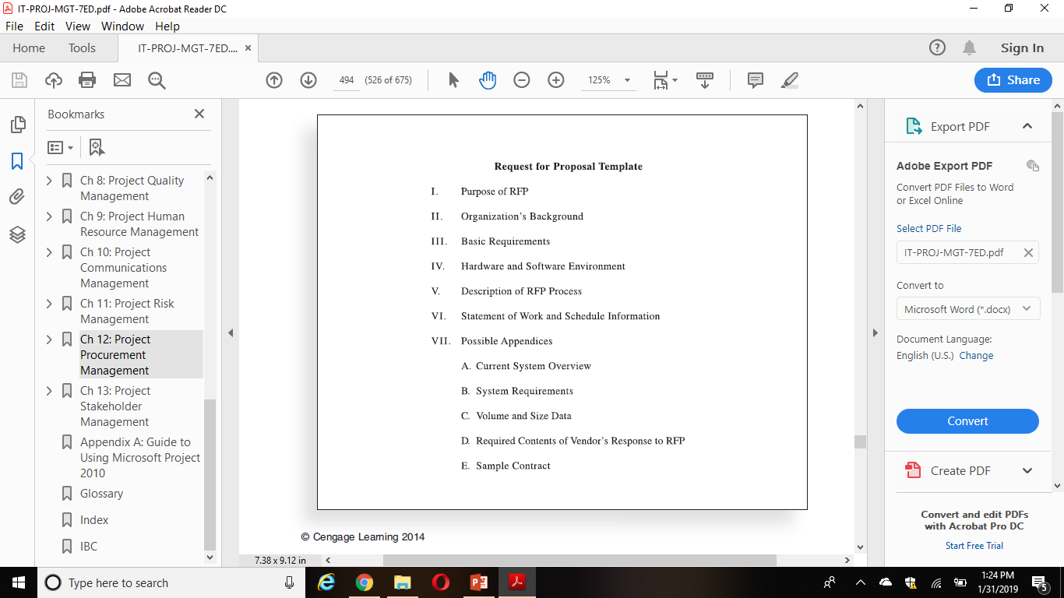

Slide 21
Conducting Procurements
Involves deciding whom to ask to do the work, sending appropriate documentation to potential sellers, obtaining proposals or bids, selecting a seller, and awarding a contract
The buying organization is responsible for advertising the work, and for large procurements, the organization often holds some sort of bidders’ conference to answer questions about the job.
A bidders’ conference can help clarify the buyer’s expectations
Two of the main outputs of this process are a selected seller and procurement contract award.

Slide 22
Source Selection Criterion
It is very important for organizations to prepare some form of evaluation criteria for source selection, preferably before they issue a formal RFP
Organizations use criteria to rate or score proposals, and they often assign a weight to each criterion to indicate its importance.
Some examples of criteria and weights include the technical approach (30 percent weight), management approach (30 percent weight), past performance (20 percent weight), and price (20 percent weight).
The criteria should be specific and objective
A key factor in evaluating bids, particularly for projects involving IT, is the past performance record of the bidder.
The RFP should require bidders to list other similar projects they have worked on and provide customer references for those projects.

Slide 23
Reviewing performance records and references reduces the risk of selecting a supplier with a poor track record.
Suppliers should also demonstrate their understanding of the buyer’s need, their technical and financial capabilities, their management approach to the project, and their price for delivering the desired goods and services.
It is also crucial to write the contract to protect the buyer’s interests.
Some IT projects also require potential sellers to deliver a technical presentation as part of their proposal.
When the outside project manager leads the proposal presentation, the organization can build a relationship with the potential seller from the beginning.
Visits to contractor sites can also help the buyer get a better feeling for the seller’s capabilities and management style.

Slide 24
Supplier Selection
Once buyers receive proposals or bids, they can select a supplier or decide to cancel the procurement.
Selecting suppliers or sellers, often called source selection, involves evaluating proposals or bids from sellers, choosing the best one, negotiating the contract, and awarding the contract.
Several stakeholders in the procurement process should be involved in selecting the best supplier for the project
There might be a technical team, a management team, and a cost team to focus on each major area.
Buyers often develop a short list of the top three to five suppliers to reduce the work involved in selecting a source.
Experts in source selection highly recommend that buyers use formal proposal evaluation sheets during source selection.

Slide 25
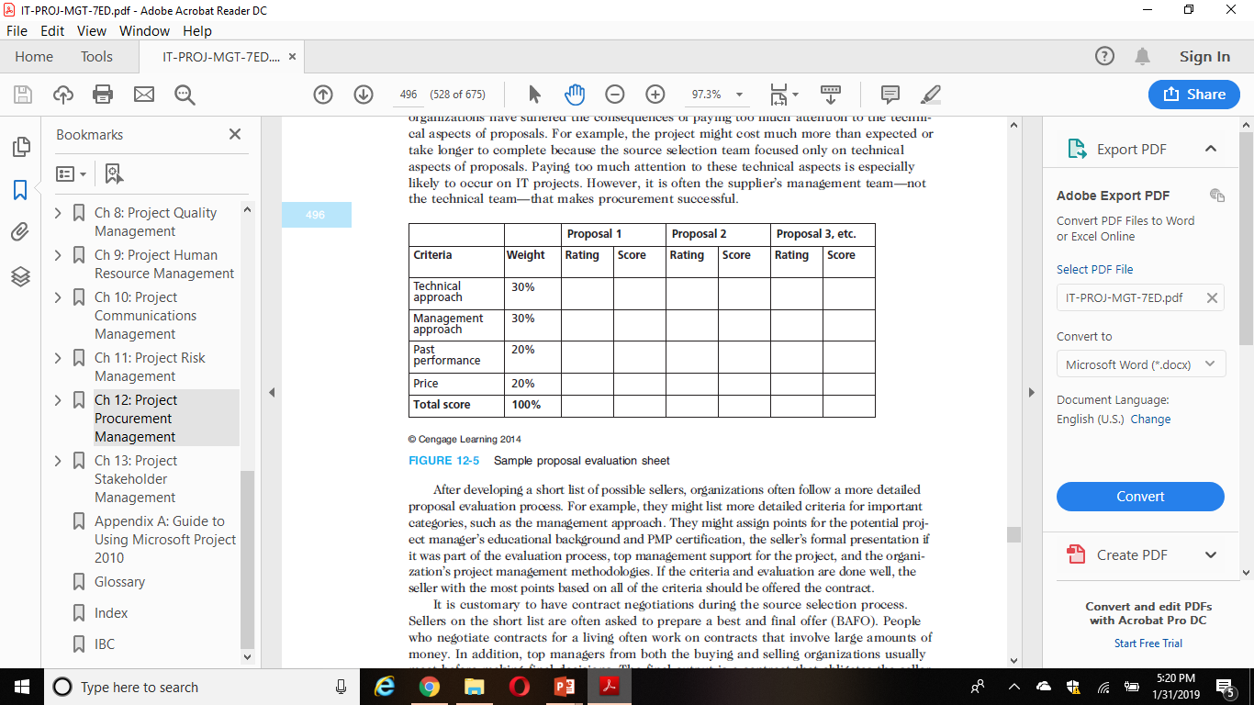
Sample proposal evaluation sheet

Slide 26
After developing a short list of possible sellers, organizations often follow a more detailed proposal evaluation process.
It is customary to have contract negotiations during the source selection process.
Sellers on the short list are often asked to prepare a best and final offer (BAFO).
The final output is a contract that obligates the seller to provide the specified products or services and obligates the buyer to pay for them

Slide 27
Contract Administration / Controlling Procurement
Ensures that the seller’s performance meets contractual requirements
It is very important that appropriate legal and contracting professionals be involved in writing and administering contracts
Project team members must be aware of potential legal problems they might cause by not understanding a contract.
Change control is an important part of the contract administration process.
It is critical that project managers and team members watch for constructive change orders, which are oral or written acts or omissions by someone with actual or apparent authority that can be construed to have the same effect as a written change order
Notes:
change control is an important part of the contract administration process.

Slide 28
Suggestions for Change Control in Contracts
Changes to any part of the project need to be reviewed, approved, and documented by the same people in the same way the original part of the plan was approved
Evaluation of any change should include an impact analysis. How will the change affect the scope, time, cost, and quality of the goods or services being provided?
Changes must be documented in writing. Project team members should also document all important meetings and telephone phone calls
Project managers and teams should stay closely involved to make sure the new system will meet business needs and work in an operational environment
Have backup plans
Use tools and techniques, such as a contract change control system, buyer-conducted performance reviews, inspections and audits, and so on

Slide 29
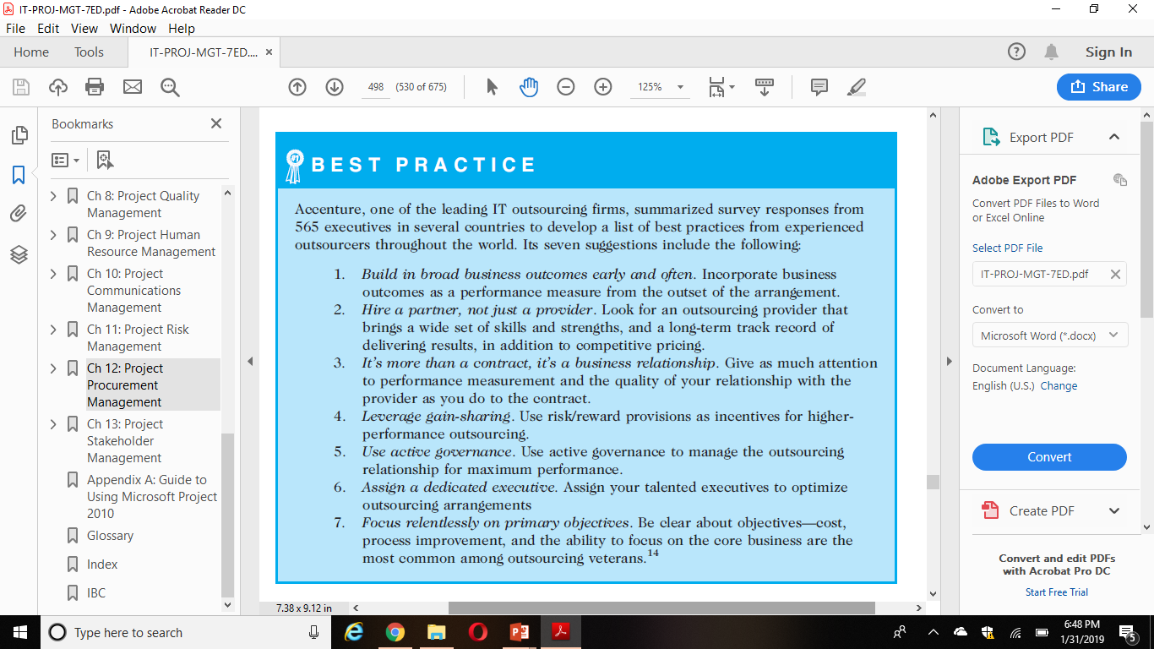

Slide 30
Closing Procurements
Contract closure / Closing procurements involves completion and settlement of contracts and resolution of any open items.
The project team should determine if all work required in each contract was completed correctly and satisfactorily.
The team should also update records to reflect final results and archive information for future use.
Tools to assist in contract closure include procurement audits, negotiated settlements, and a records management system.

Slide 31
Procurement audits are often done during contract closure to identify lessons learned in the entire procurement process. Organization should strive to improve all of their business processes, including procurement management.
All procurements should end in a negotiated settlement between the buyer and seller. If negotiation is not possible, then some type of alternate dispute resolution such as mediation or arbitration can be used
A records management system provides the ability to easily organize, find, and archive procurement-related documents
Outputs from contract closure include closed procurements and updates to organizational process assets. The buying organization often provides the seller with formal written notice that the contract has been completed. The contract itself should include requirements for formal acceptance and closure

Slide 32
Public procurement legalities in local context such as Nepalese PPMO guidelines
The Guidelines are made up of 18 sections:
Introduction,
General Considerations,
Applicability of the Guidelines,
Background Information,
Technical Specifications and Methods of Procurement,
Public Procurement Procedure,
Bid Evaluation and Recommendation,
Procurement of Consulting Services,
Provisions Relating to Procurement Contract,
Blacklisting of Bidder etc.,
Provisions Relating to Review of Decision,
Institutional Provisions,
Miscellaneous,
Main Provision Related to Development Financing Agreement between GoN and IDA, and
Provisions Related to House/Land Renting and service Contract.

Slide 33
Background Information: Legal and Institutional Arrangement for Public procurement
Public procurement in Nepal is governed by the Public Procurement Act (PPA) of 2006 and Public Procurement Regulations (PPR) of 2007
The government has established the Public Procurement Monitoring Office (PPMO) for the purpose of offering the necessary advice, promulgating the necessary guidelines, facilitating public procurement by preparing standardized examples of bid/tender documents, monitoring the process of public procurement, and submitting an annual report
Every public entity is required to establish a Procurement Unit for the purpose of public procurement.

Slide 34
Function of Procurement Unit
Principles/Aims of Public Procurement
Procurement Cycle, Procurement Stages and Steps, Public Procurement Procedure

Slide 35
Procurement Preparation and Planning
Procuring entities are required to prepare a Procurement Plan so that procurement is done within the available financial resources, within other applicable limitations, at the most favourable time, and by adopting bulking where feasible to achieve economies of scale.
Responsibility for Procurement Work
Preparation for Procurement Works
Procurement Planning: A Procurement Plan comprises, where applicable, a Master Procurement Plan and an Annual Procurement Plan.
Determination of Qualification of Bidder/Proposer

Slide 36
Provisions Relating to Tender/Bid
Process and stage of Tender
Determination of Prequalification
Preparation of Tender documents
Invitation for Tender/Pre-qualification
Tender/Bid Invitation upon preparation of Bid documents for procurement exceeding NRs. 1 Million
Time period for submitting Tender/Bid/Pre-qualification Proposal (Article 14-(4)) – minimum 30 days for National Competitive Bidding and 45 days for International Bidding
Conditions for Invitation for International Bidding
Information to be mentioned in the notice for invitation for Bid/tender/ Pre-qualification
Requirement for Performance/Bid Bond/Ernest Money and Condition for its forfeiture
Fee for Tender/Bid Documents
Clarification of Tender or PQ documents in relation to any unclear matter
Deadline for submission of Tenders or PQ proposals

Slide 37
Manner of submitting Tenders
Return and amendment of Tender
Period of validity of Tenders
Bid Issuance/ Sales & Registration Book to be maintained and receipt to be given
Security of Submitted Bid Documents
Return of Bid Document and Amendment
Tender/Bid Security
Opening of Tenders
Examination of Tenders/Bids
Non-acceptance of Tender
Evaluation of Tenders
Rejection of Tenders or cancellation of procurement proceedings
Acceptance of Tender and Procurement
Two-stage Tendering
Domestic Preference may be given
Details of local agent to be mentioned by Foreign Bidder

Slide 38
Bid Evaluation and Recommendation
Opening of Bid
Examination/Inspection of Bid
Non-Acceptance of Tender/Bid
Bid Evaluation
Special Evaluation of Bids of Construction Works
Evaluation Report of Bids with recommendation to be submitted
Authority to approve Bid/Tender
Rejection of Tenders or Cancellation of the Procurement process
Sample/Specimen of Goods
Bid Approval and Procurement Contract Agreement
Arrangement regarding Sealed Quotation
Evaluation and recommendation of Sealed Quotation
Approval and Contract Agreement of Sealed Quotation

Slide 39
Provisions Relating to Procurement Contract
Procurement Contract and Conditions thereof
Requirement to indicate Budget Code
Performance Bond to be submitted for Agreement
Provision concerning execution of Contract
Amendment to Procurement Contract
Time Extension of Procurement Contract
Provision for Advance Payment and Reconciliation
Appointment of Client’s Representative for Pre-shipment Inspection
Inspection and Approval of Goods
Auction of Goods and Appropriation of Dues
Work Acceptance Report
Variation Order

Slide 40
Price Adjustment in Procurement Agreement
Provision and Procedure for Time Extension of Contract period
Content of Bill or Invoice
Payment of Bill or Invoice
Final Payment
Due Payment upon Termination of Contract by Public Entity for Public Welfare on Convenience ground
Liquidated Damages
Mechanism for Dispute Resolution
Termination of Procurement Contract and Remedies
Remedies Available upon Breach of Procurement Contract
Public Notice of Procurement Contract

Slide 41
Provisions Relating to Procurement Proceedings or Review of Decision
Details to be mentioned in the Application to be submitted to the Head of the Public Entity
Details to be mentioned in the Application to be submitted to the Review Committee for Review of Procurement Contract
Nature of the Review Committee’s Decision
Security Money to Be Deposited for Review
Suspension of Procurement Proceedings
Method of Sending Application for Review

Slide 42
E-bidding procedures
Provisions Relating to Tender/Bid
The bidding process is used to select a vendor for subcontracting a project, or for purchasing products and services that are required for a project.
Bid records contain the specifications of the project or details of the products and services to be purchased.
E-bidding is of the stages in the e-procurement process
E-bidding is the process of bidding through electronic medium

Slide 43
E-BIDDING: MERITS
Is more transparent
Helps check unwarranted pressure on bidding
Promotes free and fare competition (saves valuable Government budget)
Saves time
Record of bidding can be easily extracted for future reference

Slide 44
E-bidding Module
Component | Can do | Cannot do | Password
Site Administrator | Register buyer/bidder | Access bidding process | Has own password
Buyer | Publish/Download/Award tender | Access bidder’s Page | Needs password
Bidder | Submit/ Modify Bids | Access buyer’s page / Delete bid | Needs password
General viewer | View tenders | Access building process | Doesn’t need password

Slide 45
FACILITY MADE AVAILABLE IN MODULE
Tender Notice, Bid information by Buyer
Amendment by Buyer
Bid submission by Bidder
Modification/substitution/withdrawal by Bidder
Secure submitted Bids
Bid opening and acquire bids for evaluation
Notice of successful bidder
E-BIDDING: INFORMATION AVAILABLE ON SITE
Information About E-procurement
Tenders
Awarded Contracts
Frequently Asked Questions

Slide 46
Legal Framework – Moving toward e-Procurement in Nepal
Public Procurement Act (PPA) has a provision to use ICT as a tool to achieve the objective of Public procurement.
Clause 69 : Use of electronic communications means for public procurement transaction:
Invite a pre-qualification proposal,
Issue notice of bid invitation,
Prepare a short list by inviting expression of interest,
Invite a proposal of consultancy service,
Transmit bidding or pre-qualifying documents,
Receive bids, proposals for pre-qualification or consultancy services,
Conclude the procurement contract
Make payment and
Give and receive other notices

Slide 47
Online/Offline Process
Online Process:
PE have to upload necessary files and have to input the data as required in the specified modules and at last bid document is generated by the system
In this process, Bidder can also input the data in online modules as specified in the system i.e. specified online modules are also presented in bidder side.
Online modules are activated when PEs chooses PPMO Document format selected
Offline Process:
PEs have to create the bid document offline/manually and they can upload that bid document in the system
Bidder have to download the bid document, fill the necessary information in the downloaded document, then the prepared document is uploaded while bidding.
When ADB, Word Bank, Ration, Other document type is selected

Slide 48
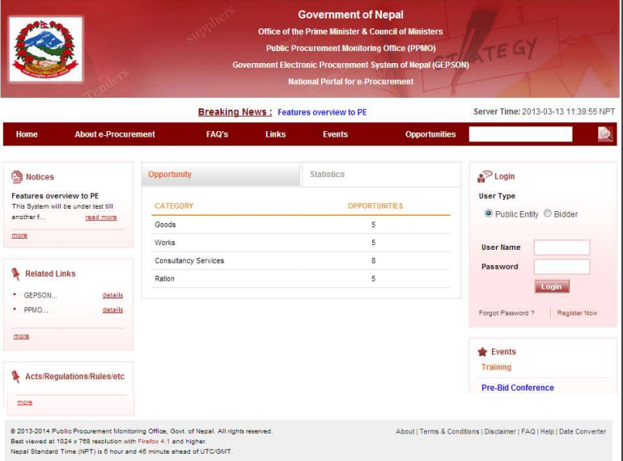

Slide 49
Features of the System
User Registration - Public Entity User & Bidder
User Roles
Super Admin
Admin
Creator
Reviewer
Approver
Administrative Features
Links
Notice
Training
Authorization
Item List
Acts/Rules/Regulations

Slide 50
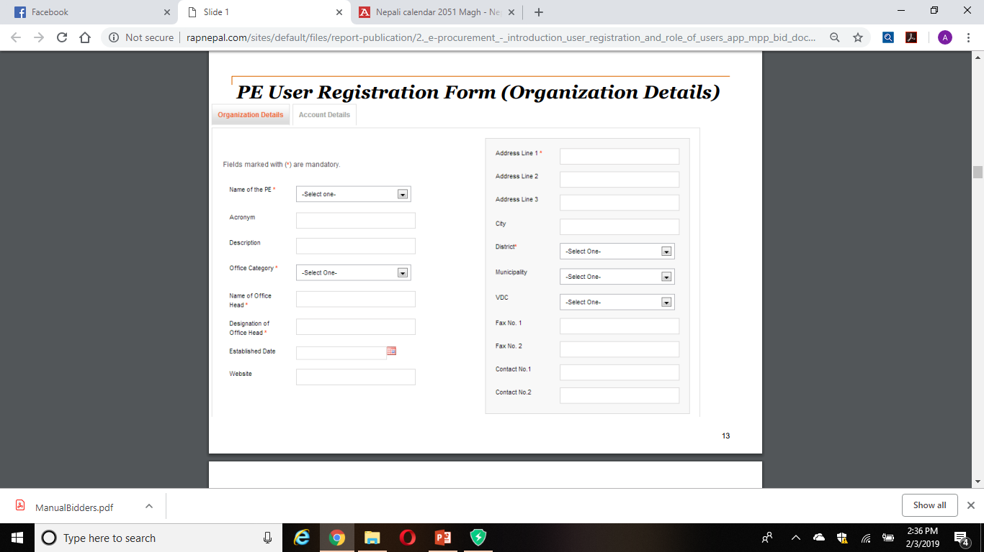

Slide 51
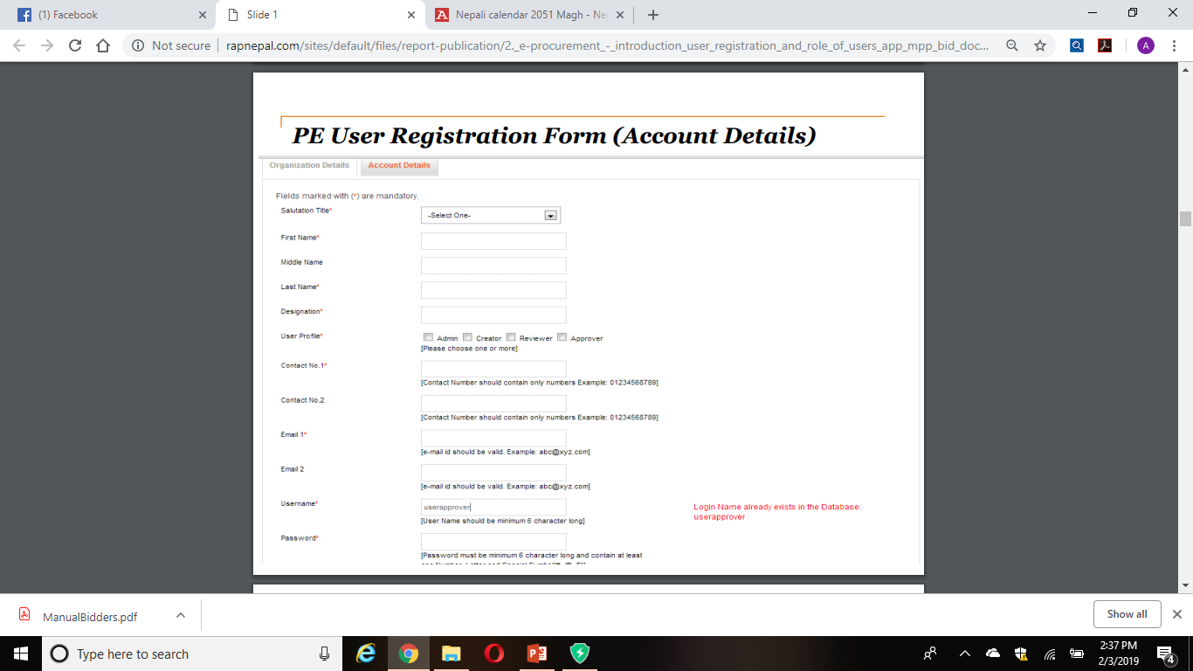

Slide 52
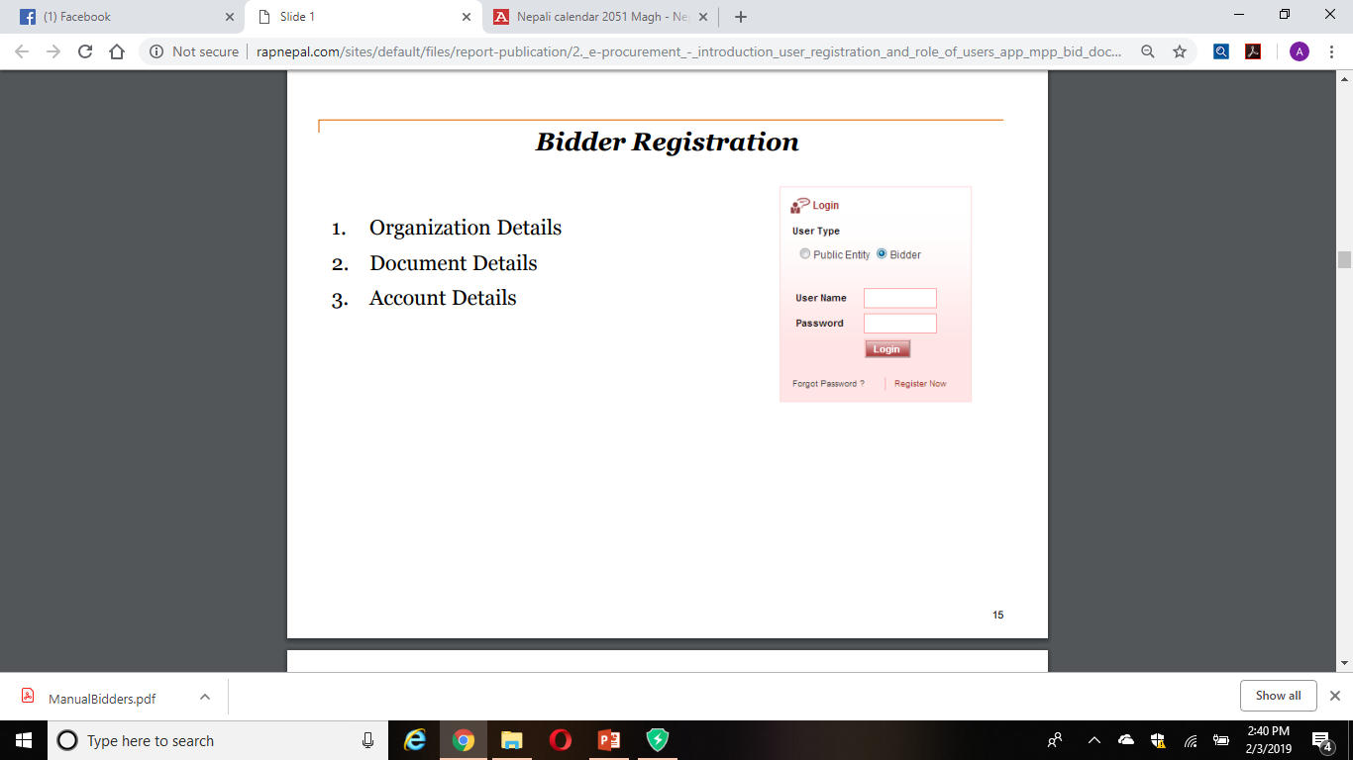

Slide 53
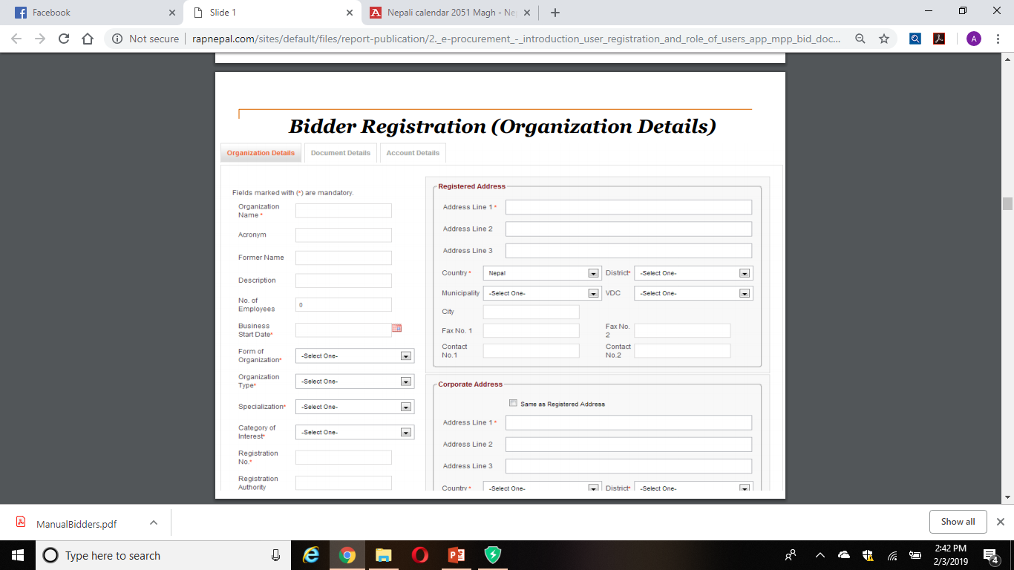

Slide 54
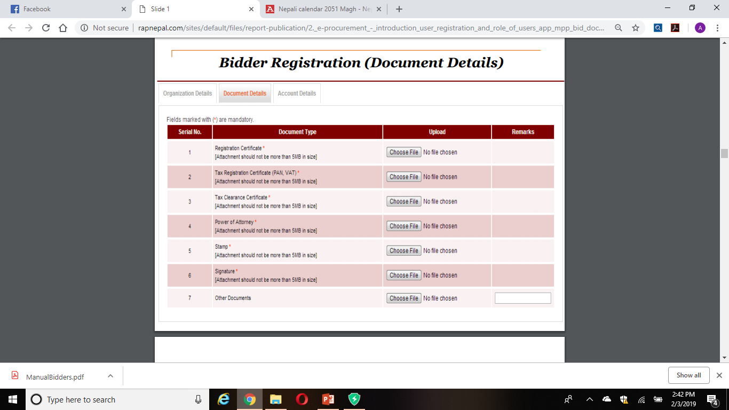

Slide 55
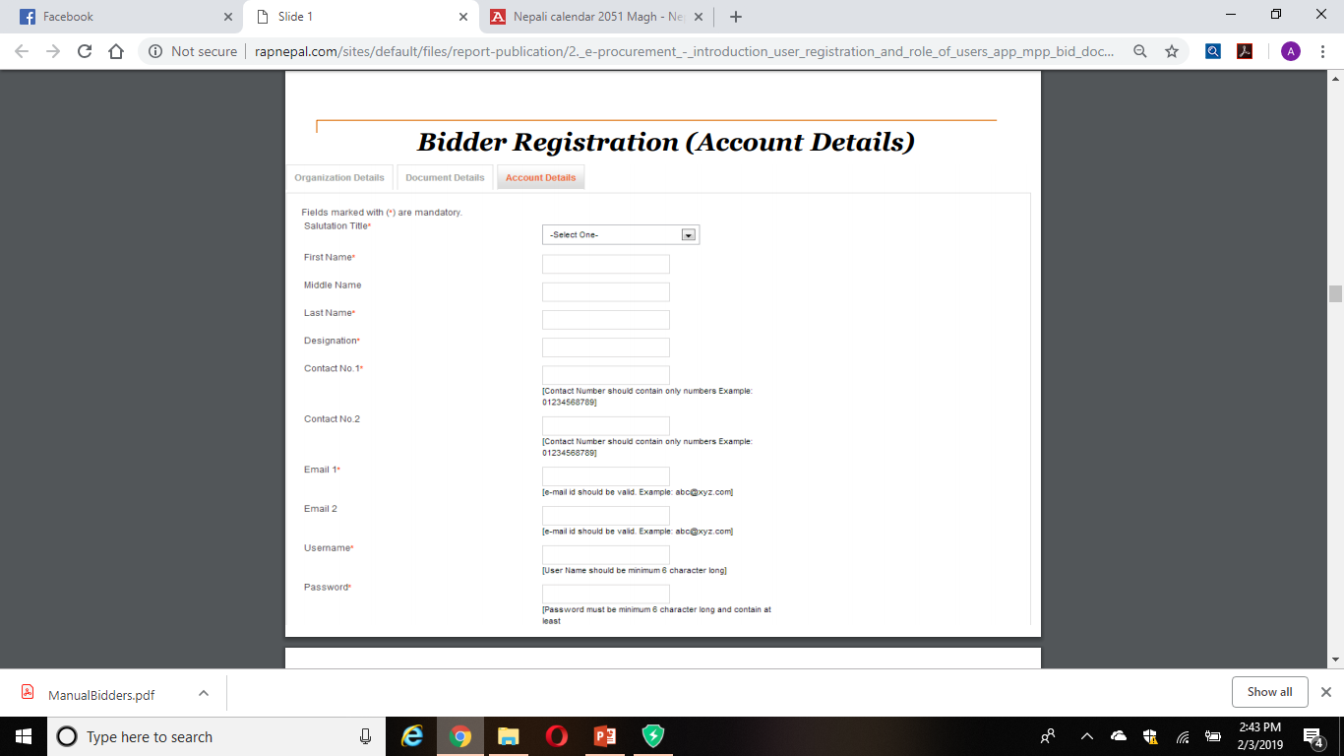

Slide 56
Features of the System (Cont...)
Directory
Qualified/ Shortlisted
Bid Opening Committee
Blacklist
Reports
Master Procurement Plan (MPP)
Annual Procurement Plan (APP)
Procurement Requisition Form (PRF)
Creation of Bid Document

Slide 57
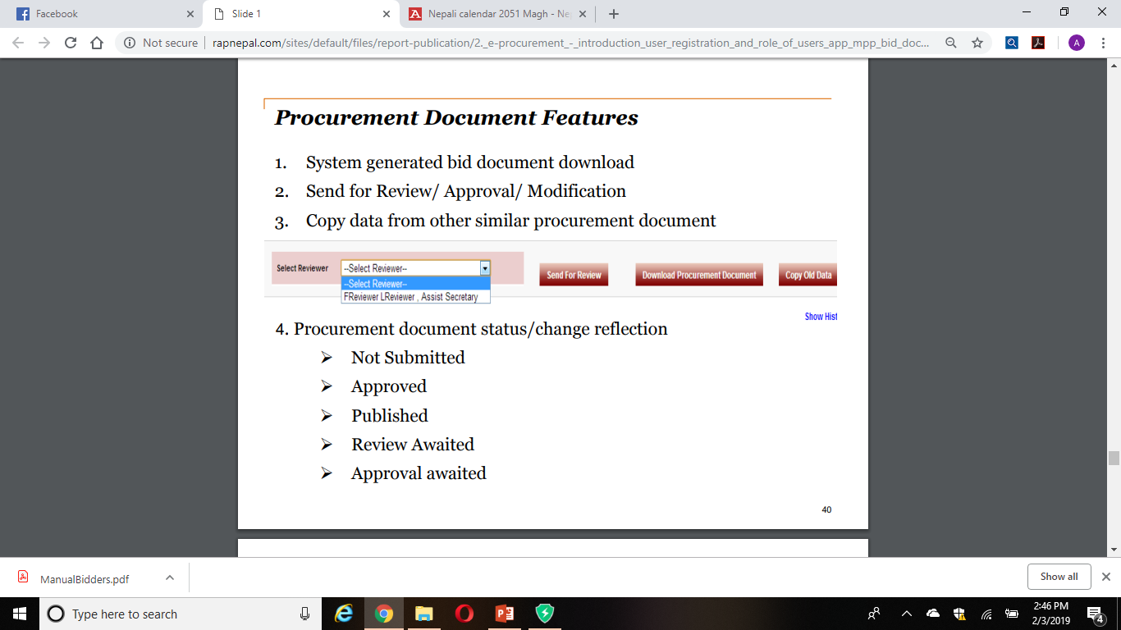

Slide 58
Not Fully Automated under First Phase of development and Implementation
A system can be automated from one level to another level only where some standard set of working procedure has been already defined. Manual Works which is not in scope for current phase:
Payment
Evaluation
Contract Management
Catalogue Management

